Slide 1

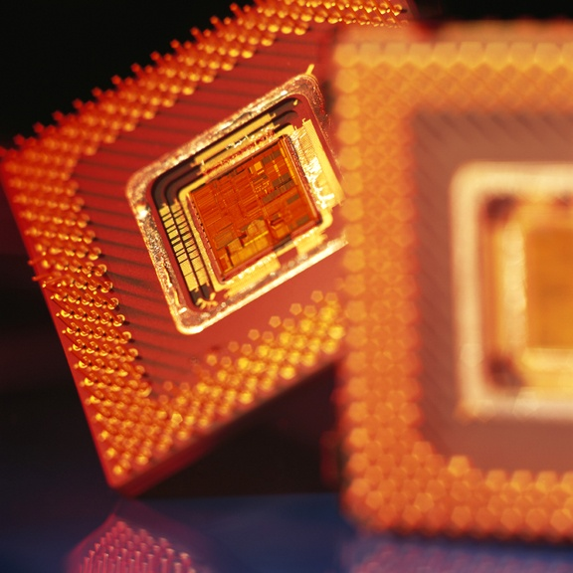
Entering a New Millennium,
1981–Present
Conservatives change domestic policy, world events affect U.S. foreign policy, technology changes daily life, and immigrants create a more diverse society.
A computer chip.
NEXT

Slide 2
Entering a New Millennium,
1981–Present
SECTION 1
Conservatives Reshape Politics
SECTION 2
Technological and Economic Changes
SECTION 3
The New Americans
NEXT

Slide 3

Section 1
Conservatives Reshape Politics
The country becomes more conservative, leading to Republican political victories.
NEXT

Slide 4
SECTION
Conservatives Reshape Politics
1
Reagan’s Conservative Goals
• President Ronald Reagan pursues conservative goals including:
- deregulation
- fewer government programs
- a conservative Supreme Court
- lower taxes, which involves supply-side
economics
Image
Continued . . .
NEXT

Slide 5
SECTION
1
continued Reagan’s Conservative Goals
• Supply-side economics:
- lower taxes allow people to save more
money
- banks loan money to businesses
- businesses invest loans to improve
productivity
- supply of goods increases, driving prices
down
- Congress lowers income taxes by 25%
over 3 years
• By 1983, inflation, unemployment decrease, business booms
• U.S. government uses deficit spending, national debt doubles
NEXT

Slide 6
SECTION
1
A Tough Anti-Communist Stand
• Reagan against Communism, builds up U.S. arms
• Intermediate-Range Nuclear Forces Treaty (INF):
- Soviet Union, U.S. agree to destroy all their
medium-range missiles
• U.S. backs El Salvador government against Communist-led rebels
Continued . . .
NEXT

Slide 7
SECTION
1
continued A Tough Anti-Communist Stand
• In Nicaragua, U.S. gives aid to anti-Communist rebels called Contras
• Iran-Contra affair—money from arms sales to Iran used to help Contras
Image
• Illegal for U.S. government to fund Contras
• Reagan claims ignorance of the deal
• Should have kept track of administration’s actions
NEXT

Slide 8
SECTION
1
Bush and a Changing World
• Reagan’s vice-president George H. W. Bush wins presidency (1988)
• Soviet republics declare independence, Soviet Union, Cold War ends
Map
• August 1990, Iraq invades Kuwait, major supplier of U.S. oil
• Persian Gulf War—U.S., UN free Kuwait from Iraqis
• Bush’s popularity increases, then drops when U.S. economy gets worse
• Democrat Bill Clinton wins presidential election (1992)
NEXT

Slide 9
SECTION
1
Clinton’s Fight with Congress
• President Clinton tries to reform health-care, meets resistance
• North American Free Trade Agreement (NAFTA):
- eliminates tariffs, increases trade, Mexico,
Canada, U.S.
• Clinton, Congress stalemate, reach compromise on budget
• Clinton, Congress work together to pass welfare reform
Continued . . .
NEXT

Slide 10
SECTION
1
continued Clinton’s Fight with Congress
• Clinton reelected (1996), accused of improper relationship with intern
• Denies accusation, admits to relationship but not to lying under oath
• House approves 2 articles of impeachment of Clinton
• Clinton acquitted by Senate, remains popular, in office
NEXT

Slide 11
SECTION
1
War in Kosovo
• After WW I, Yugoslavia has 6 republics, ethnic, religious tensions
• 4 republics declare independence, Serbia, Montenegro stay, Yugoslavia
• Kosovo in Serbia, many people of Albanian descent, want independence
• Serbs want to drive Albanians out of Kosovo, use violence, murder
• Led by U.S., NATO bombs Serbia, Serbs withdraw from Kosovo
• UN peacekeepers move into Kosovo, situation remains tense
NEXT

Slide 12
SECTION
1
The 2000 Presidential Campaign
• Vice-president Al Gore, Democratic presidential candidate (2000)
• George W. Bush, Republican presidential candidate
• Gore emphasizes experience, keeping the economy healthy
• Bush attacks Gore’s connection to Clinton, lack of leadership
• Wants large income tax cut, Gore says large cut mainly help wealthy
• Gore wants smaller tax cut to help lower/middle class
NEXT

Slide 13
SECTION
1
A Close Election
• Gore/Bush election very close, TV networks predict Gore winner
• Networks change Florida prediction, whoever wins Florida wins election
• Predict Bush wins Florida, Gore concedes, prediction again changes
• Gore takes back concession, Florida vote too close to call
• Confusion about voting in Florida, Gore wants manual recount
Image
• Supreme Court stops recounts, Bush wins Florida and the election
NEXT

Slide 14
SECTION
1
Close Call Causes Controversy
• Gore wins popular vote, loses election
Map
• Efforts renewed to abolish Electoral College
• Americans want to improve ways votes are cast, counted
• Bush succeeds in passing tax plan through Republican Congress
• Democrats gain control of Senate, economy becomes sluggish
NEXT

Slide 15
Section 2
Technological and Economic Changes
Advances in science and technology improve daily life and create a global economy.
NEXT

Slide 16
SECTION
Technological and Economic Changes
2
Technology and Daily Life
• Institutions rely on computers, computer use in schools, homes grows
• Internet—worldwide computer network, changes communication
• Enables people to get info on any subject, send e-mails, shop on-line
• Cellular telephone use soars, people can carry these phones anywhere
NEXT

Slide 17
SECTION
2
A Changing Economy
• Computers fuel service economy—most jobs provide services not goods
• Information revolution has several effects:
- changes the way information is delivered
- gives people access to far more information
- improves productivity of many industries
• Computers change lives of workers, the way work is done
Image
NEXT

Slide 18
SECTION
2
Economic Change Affects Workers
• 1990s, high-tech industries create high-paying jobs, skilled workers
• Many lose factory jobs, need specialized skills, education, new jobs
• Many corporations use downsizing—reduce workers to increase profits
• Mergers create duplicate jobs, layoffs, many get part-time, temporary work
• Economy booms, unemployment drops, growth of Internet companies helps
• By 2000, many Internet companies out of business, economy slumps
NEXT

Slide 19
SECTION
2
A More Global Economy
• Technology helps build global economy, connects businesses worldwide
• Many companies use e-commerce—business conducted over Internet
• Corporations build factories, offices in other countries
• Some businesses move to other countries, many U.S. workers lose jobs
• Global trade makes economies in various countries more closely linked
NEXT

Slide 20
SECTION
2
Scientific Breakthroughs
• Technology causes medical advances, lasers, new tests help doctors
Image
• New drugs help treat cancer, AIDS
• Clone 1st mammal, creates controversy about ethics of cloning humans
• U.S., other nations build international space station, use for research
NEXT

Slide 21
Section 3
The New Americans
Due to immigration, the United States grows more diverse.
NEXT

Slide 22
SECTION
The New Americans
3
Immigrants Affect American Society
• Since 1981, most immigrants come from Asia, Latin America
Chart
• Changes to immigration law (1965) cause surge of immigration
• Newcomers seek economic opportunity, political freedom
Continued . . .
NEXT

Slide 23
SECTION
3
continued Immigrants Affect American Society
• 5 million illegal immigrants live in U.S. (1996), 2.7 from Mexico
• Do not pay income tax, but pay sales tax, often work for low wages
• Some people feel they are drain on U.S. economy
• Congress passes Immigration Reform and Control Act of 1986:
- strengthens immigration laws, enforcement
measures
• Illegal immigrants continue to come to U.S.
NEXT

Slide 24
SECTION
3
Immigrant Contributions
• Immigrants contribute to engineering, science, high-tech industries
• Important source of labor, without immigrants workforce might shrink
• Make contributions to U.S. sports, arts, culture, entertainment
Image
NEXT

Slide 25
SECTION
3
What Americans Have in Common
• Many immigrants embrace U.S. ways, clothes, customs, learn English
• Share U.S. belief in democracy, freedom
• U.S. is always evolving
• Tolerance, cooperation essential for future growth of U.S.
• Citizens of all backgrounds will be vital in shaping U.S. future
NEXT

Slide 26
This is the end of the chapter presentation of
lecture notes. Click the HOME or EXIT button.
NEXT

Slide 27



Print Slide Show
1. On the File menu, select Print
2. In the pop-up menu, select Microsoft PowerPoint
If the dialog box does not include this pop-up, continue to step 4
3. In the Print what box, choose the presentation format you want to print: slides, notes, handouts, or outline
4. Click the Print button to print the PowerPoint presentation
Print Text Version
1. Click the Print Text button below; a text file will open in Adobe Acrobat
2. On the File menu, select Print
3. Click the Print button to print the entire document, or select the pages you want to print
Print Text
Print Text
BACK

